Slide 1
CSC-350 Topics in Computer Science Spring 2024
Introductory Lecture 1
Dr. Farhan Aadil
farhan.aadil@cuiatk.edu.pk
Please turn OFF your Mobile Phones!

Slide 2
CSC-350 Topics in Computer Science Spring 2024
Introductory Lecture 1 (a)
Dr. Farhan Aadil
farhan.aadil@cuiatk.edu.pk
Please turn OFF your Mobile Phones!

Slide 3
Course Intro
Course Website
Course Outline
Recommended Books
Tools

Slide 4
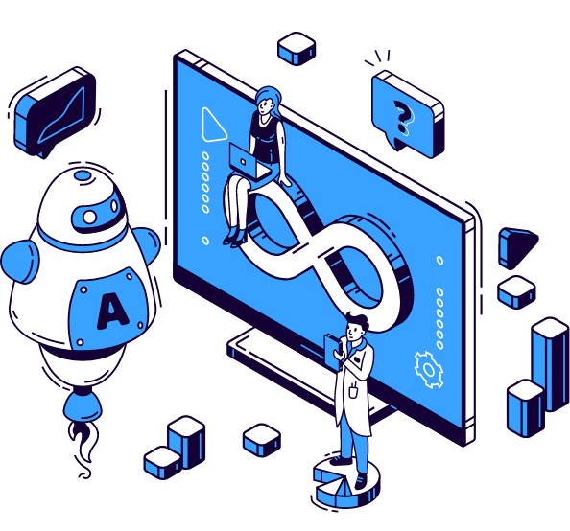

DevOps
Automation Everything You
Need to Know
Dr. Farhan Aadil
CS Department, CUI Attock

Slide 5
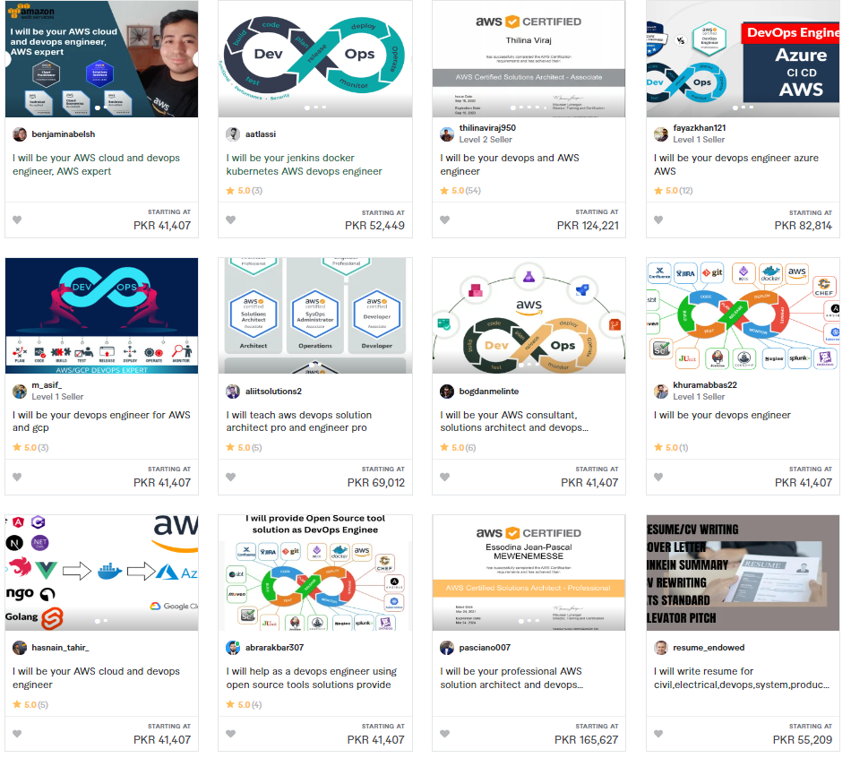
Scope of DevOps

Slide 6
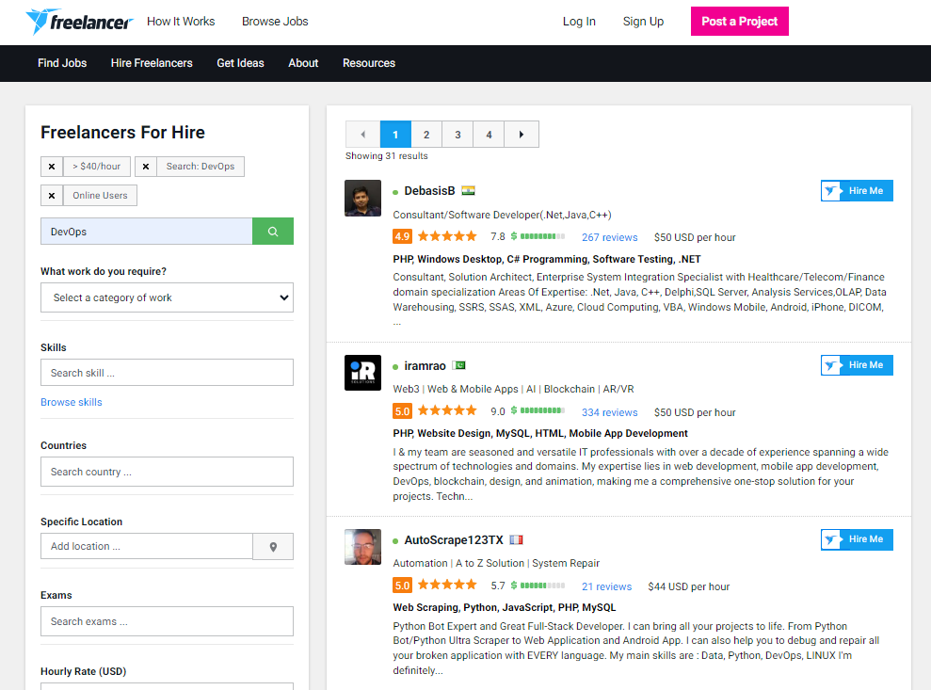
Scope of DevOps

Slide 7
“DevOps” – Real-life Stories
1. Instant Support – “ChatOps”
2. Continuous Deployment – “DevOps”
3. Infrastructure on demand – “Config Management”

Slide 8
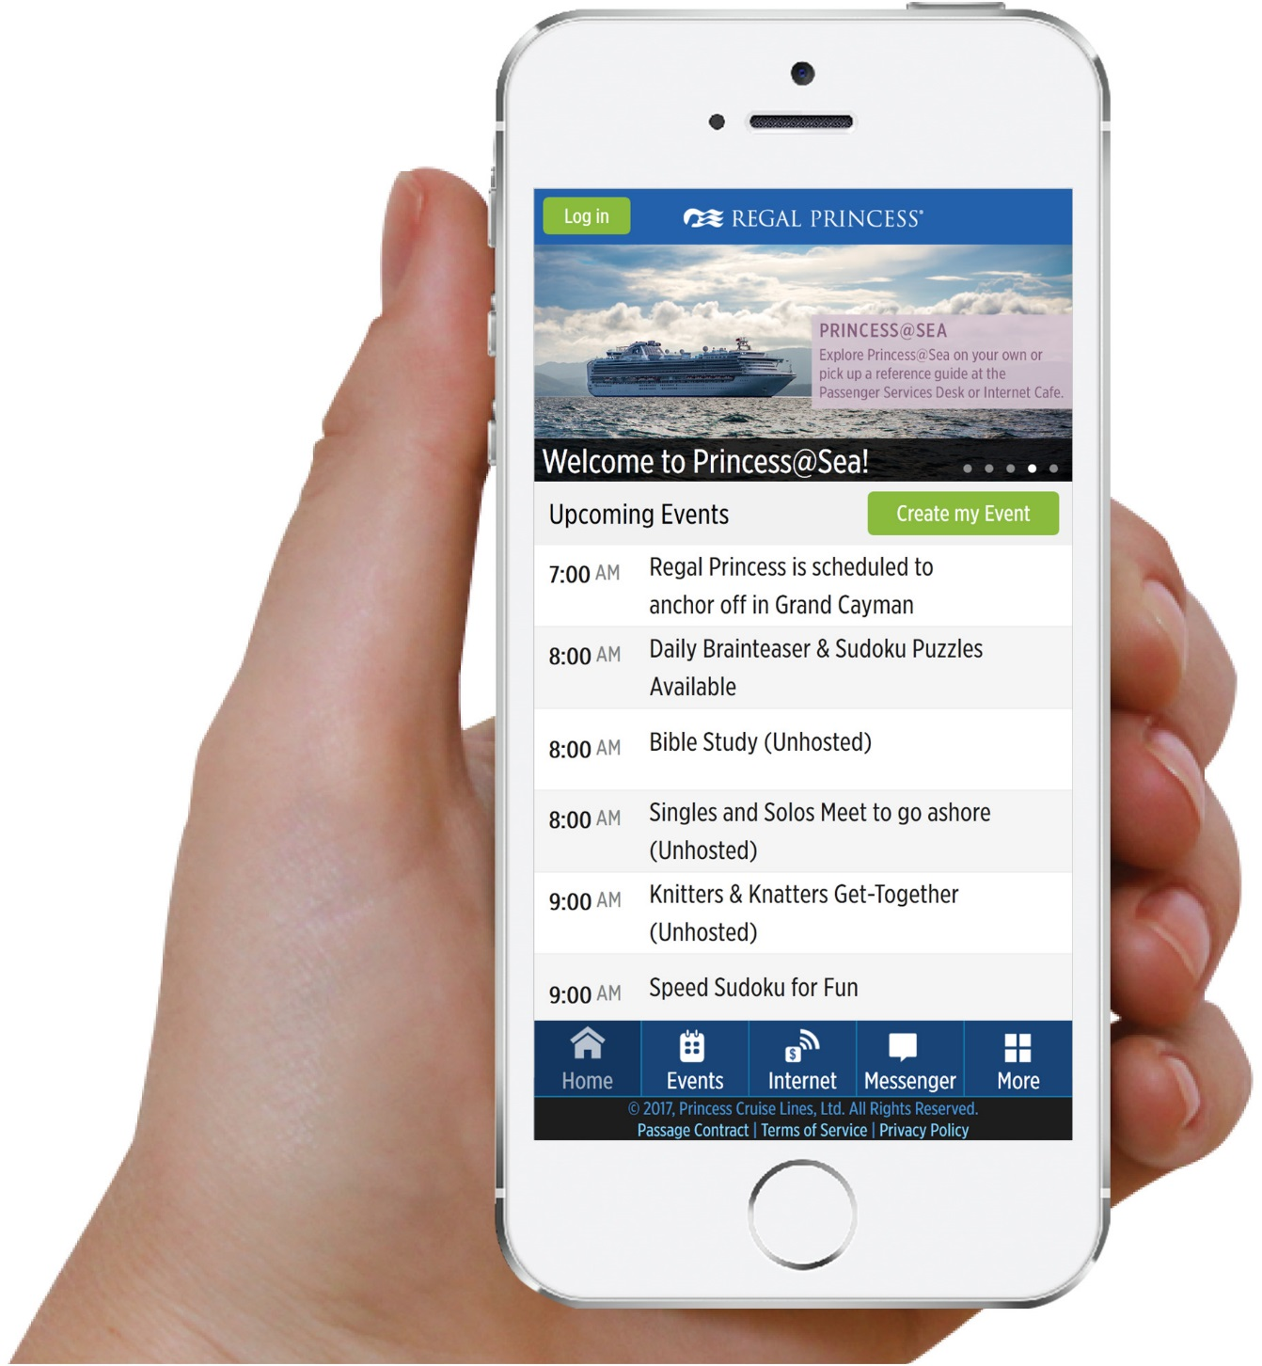
FACTS about Princess@Sea
- 18 PROD environments
- 3 application Suite per ship
- 2000+ deployments done this year
- 10 languages
- 300+ Automated Tests
- Auto roll back in PROD in case of failure
Notes:
Princess Cruises is an American cruise line owned by Carnival Corporation & plc.
The company is incorporated in Bermuda and its headquarters are in Santa Clarita, California.
As of 2021, it is the second largest cruise line by net revenue

Slide 9
Story 1 : Instant Support - ChatOps

Slide 10
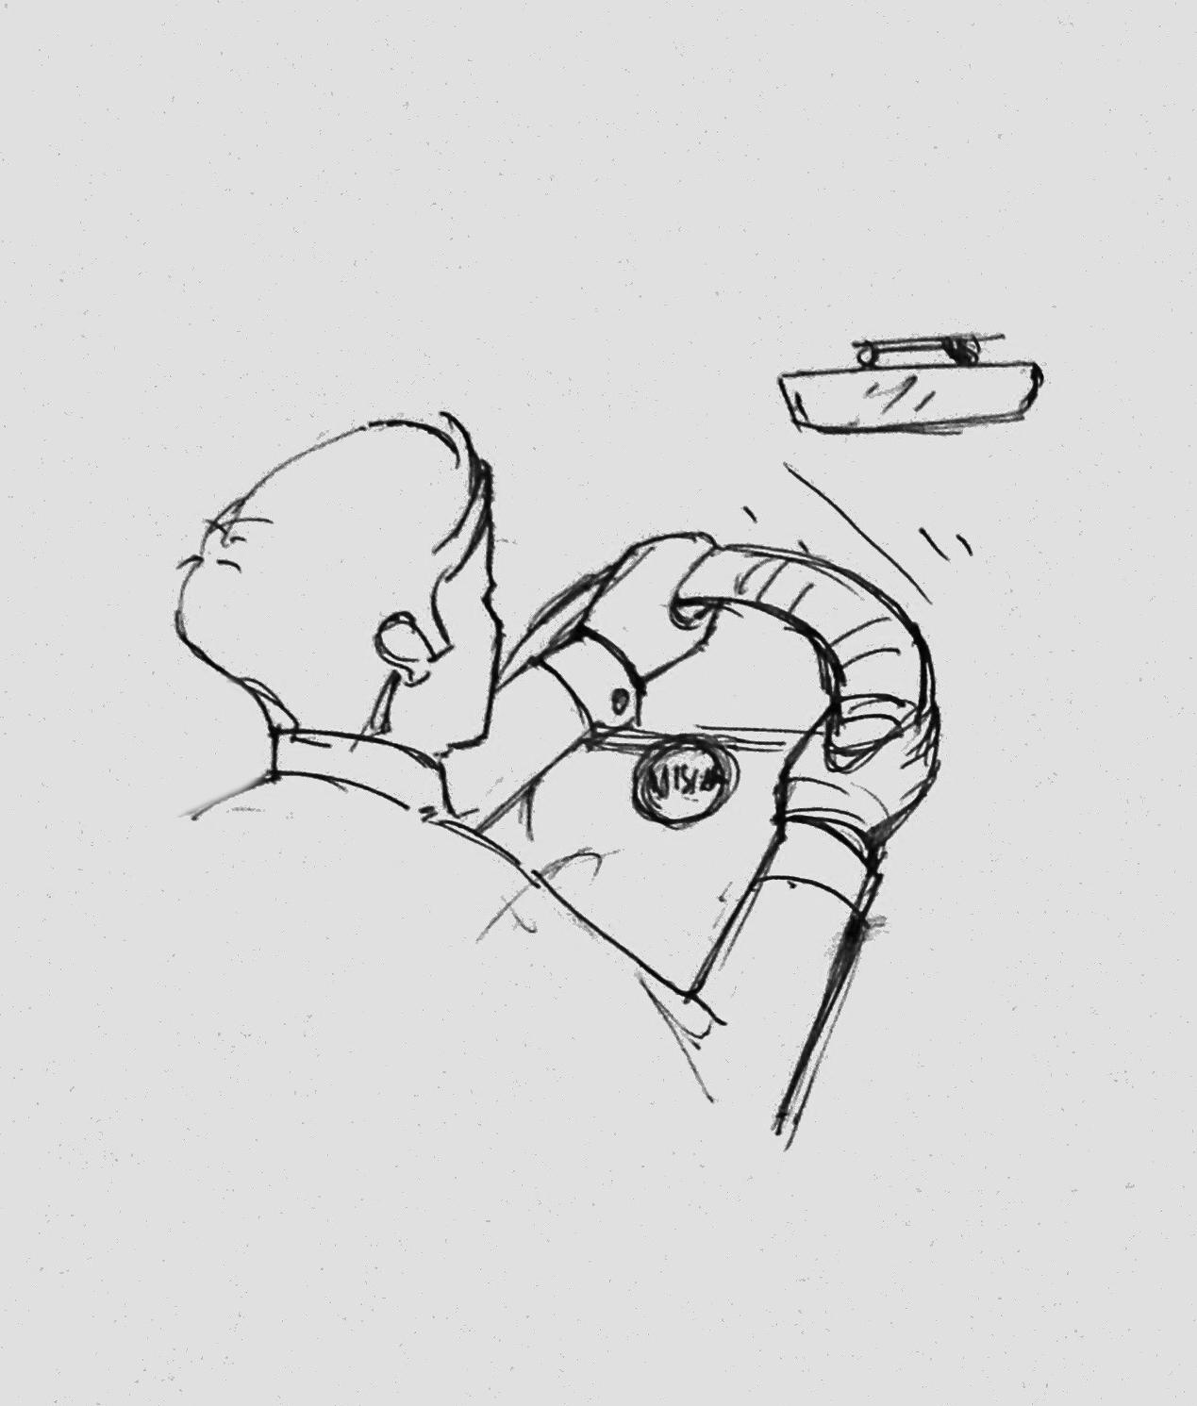
Story 1 : ChatOps
Friday Evening…
Emin is heading to hometown from office
He receives a support notification in phone

Slide 11

Story 1 : ChatOps
He stops the car and checks the message.
Hi Princess@Sea Team,
Greetings from Regal Princess.
We just crossed International dateline and some events are not showing up. Please help.
Regards,
Miguel, Regal Princess

Slide 12
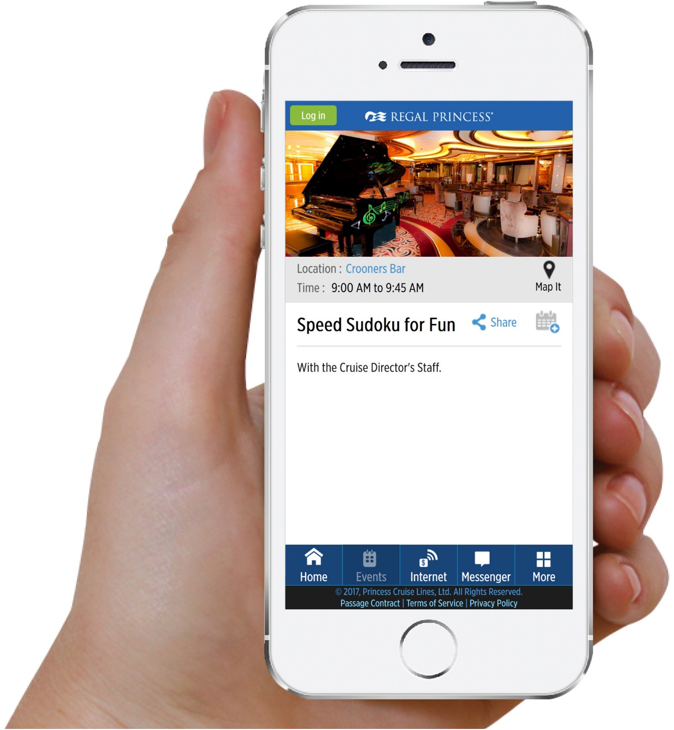
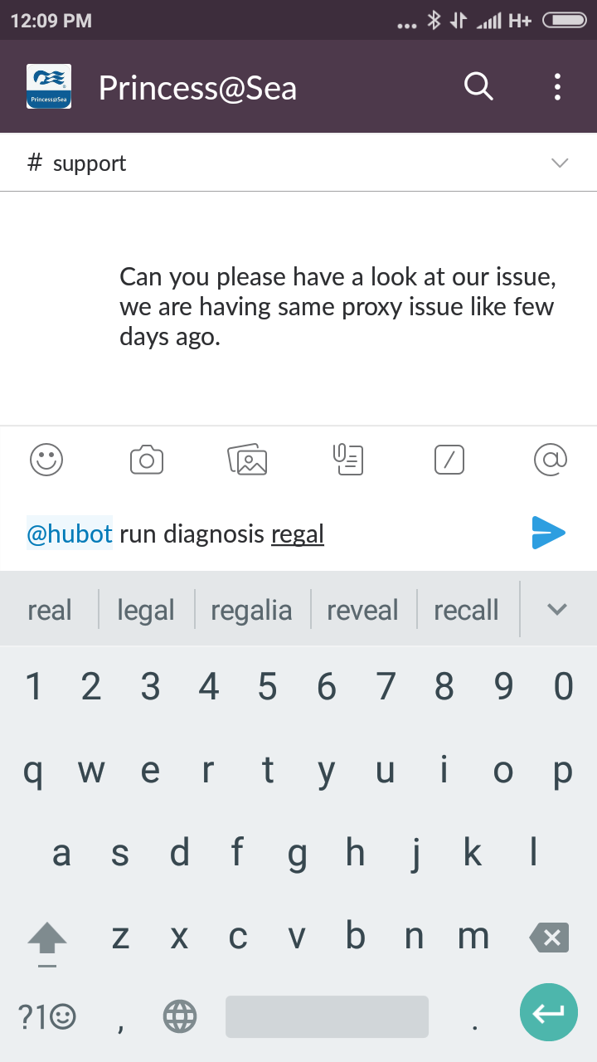
Story 1 : ChatOps
In Slack, he types…
We just crossed International dateline and some events are not showing up. Please help.
@hubot run diagnosis REGAL

Slide 13
Story 1 : ChatOps
And…
Emin continues his journey
The End!

Slide 14

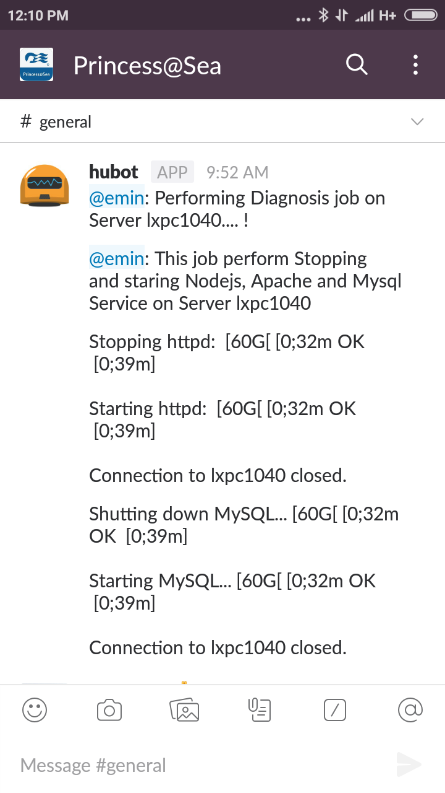
Behind the Scenes…
Hubot → Jenkins → PROD

Slide 15
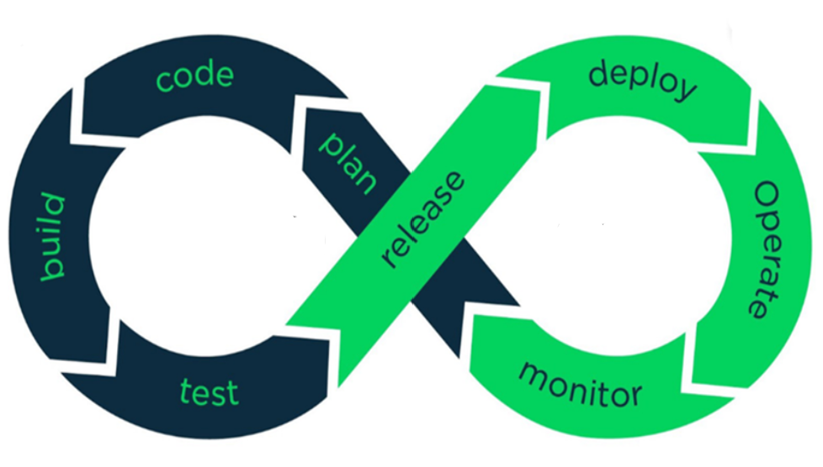
Development
Operations
Notes:
Graphic: https://www.brainvire.com/devops/ (with modifications from AFIT)
DEV/OPS uses automation and monitoring of short dev cycles, frequent deployments and aligns with business operations

Slide 16
Story 2 : Continuous Delivery - DevOps

Slide 17

Story 2 : DevOps
Monday morning…
Usman decides to put in a permanent fix for the time zone issue

Slide 18
Story 2 : DevOps
Vagrant Up
Writes Code
Writes Behat Tests – BDD
Tests in his local machine
Commits to Stash
6. Breaks for Tea
Notes:
Behat — a php framework for auto testing your business
Behat is a test framework for behavior-driven development written in the PHP programming language.\
Stash Financial, Inc., or simply Stash, is an American financial technology and financial services company based in New York, NY.

Slide 19
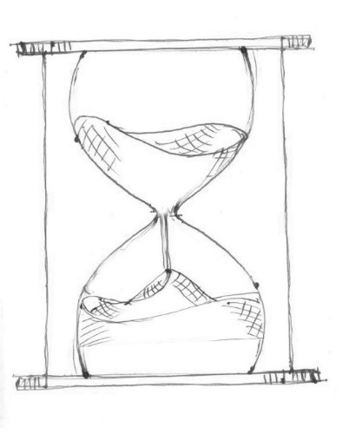
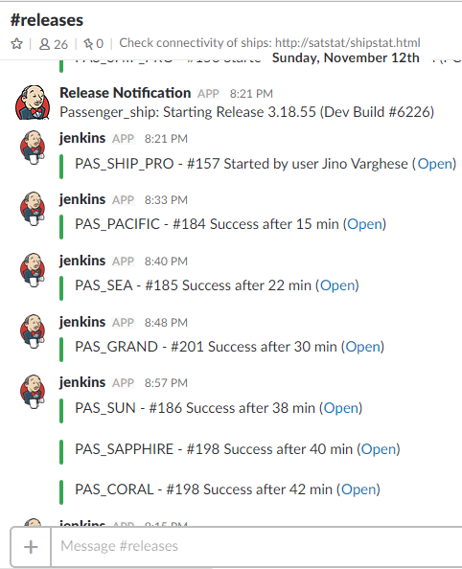
Story 2 : DevOps
2 hours later…
Auto BOT confirms successful release to Regal Production

Slide 20
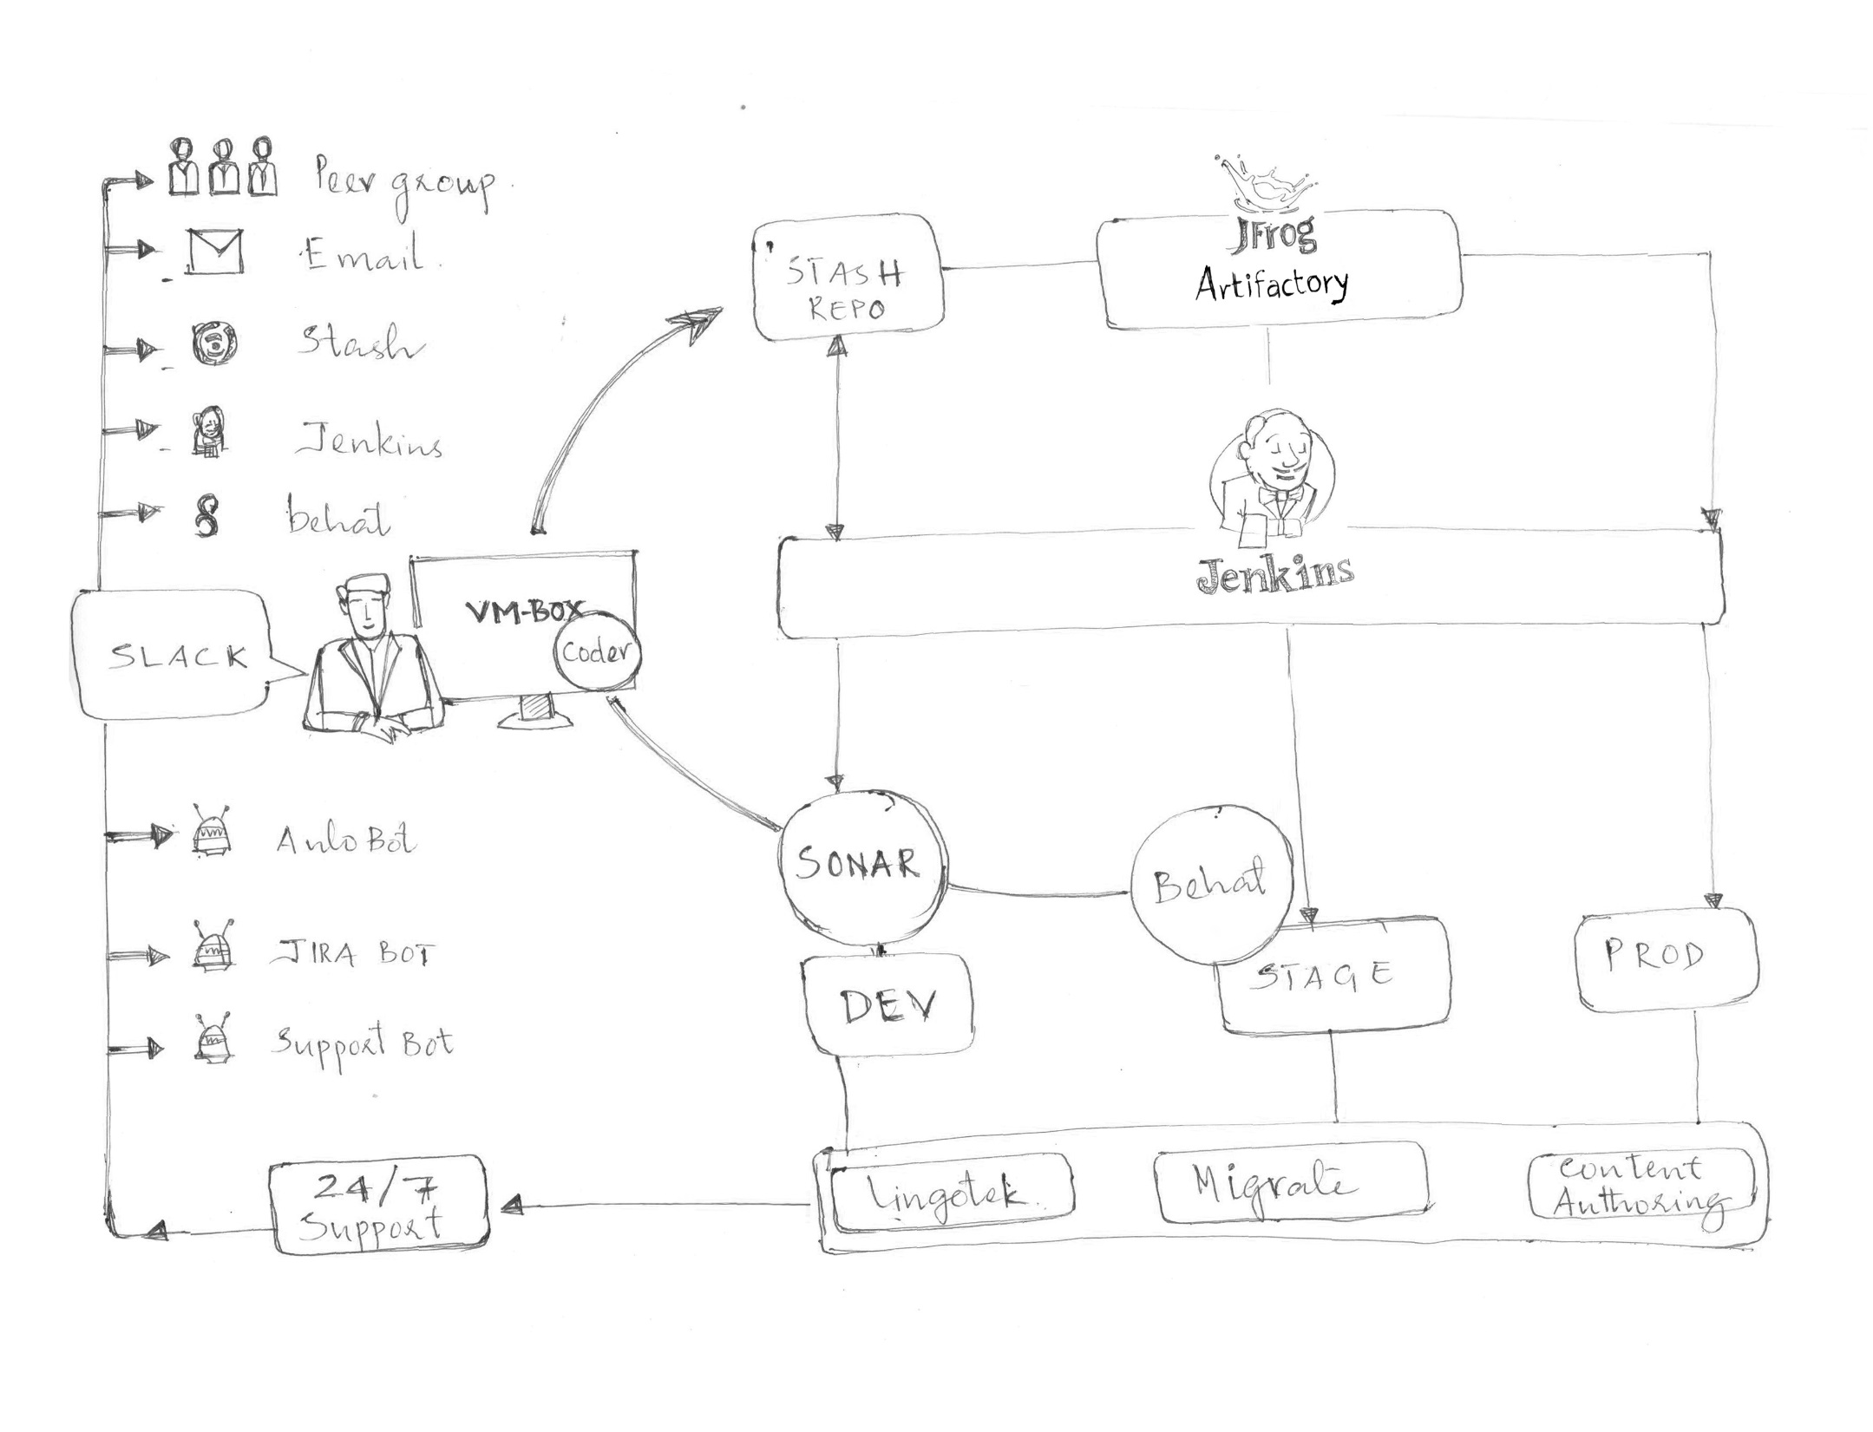
Behind the Scene…
Story 2 : DevOps
Notes:
SonarQube is an open-source platform developed by SonarSource for continuous inspection of code quality to perform automatic reviews with static analysis of code to detect bugs, code smells on 17 programming languages.

Slide 21
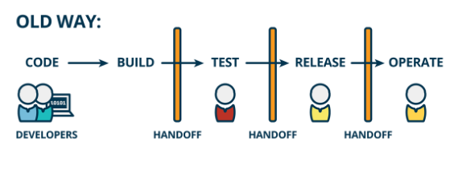

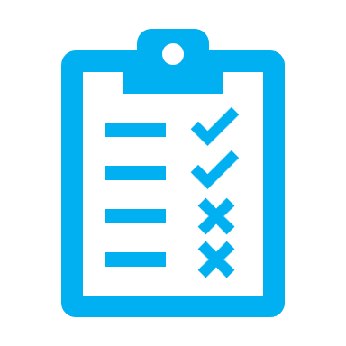
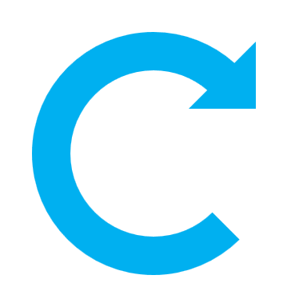
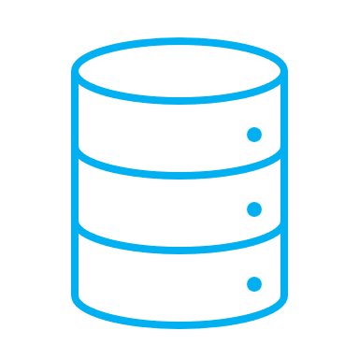

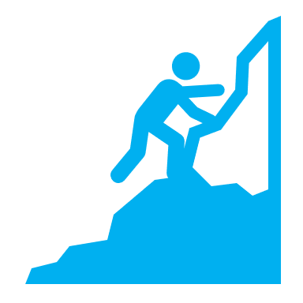






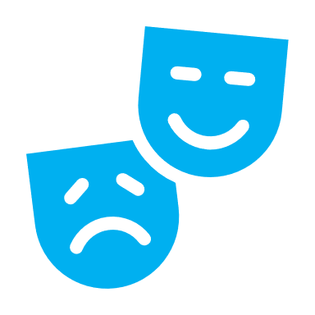

Continuous Integration (CI)
Continuous Delivery
Notes:
Picture: https://www.cprime.com/resources/what-is-agile-what-is-scrum/; Consulting firm

Slide 22
Development
Operations
Notes:
Graphic: https://www.brainvire.com/devops/ (with modifications from AFIT)
DEV/OPS uses automation and monitoring of short dev cycles, frequent deployments and aligns with business operations

Slide 23
Story 3 : Configuration Management

Slide 24

Story 3 : Config Mgmt
Omer gets a call from ship saying “we had a major power failure and servers are crashed. A new server had to be created to avoid outage for guests. Deploy Princess@Sea URGENTLY again.”
Omer Replies : “The application will be up in 10 minutes”
Omer leaves for lunch.
He gets confirmation that Princess@Sea is back up and running!

Slide 25
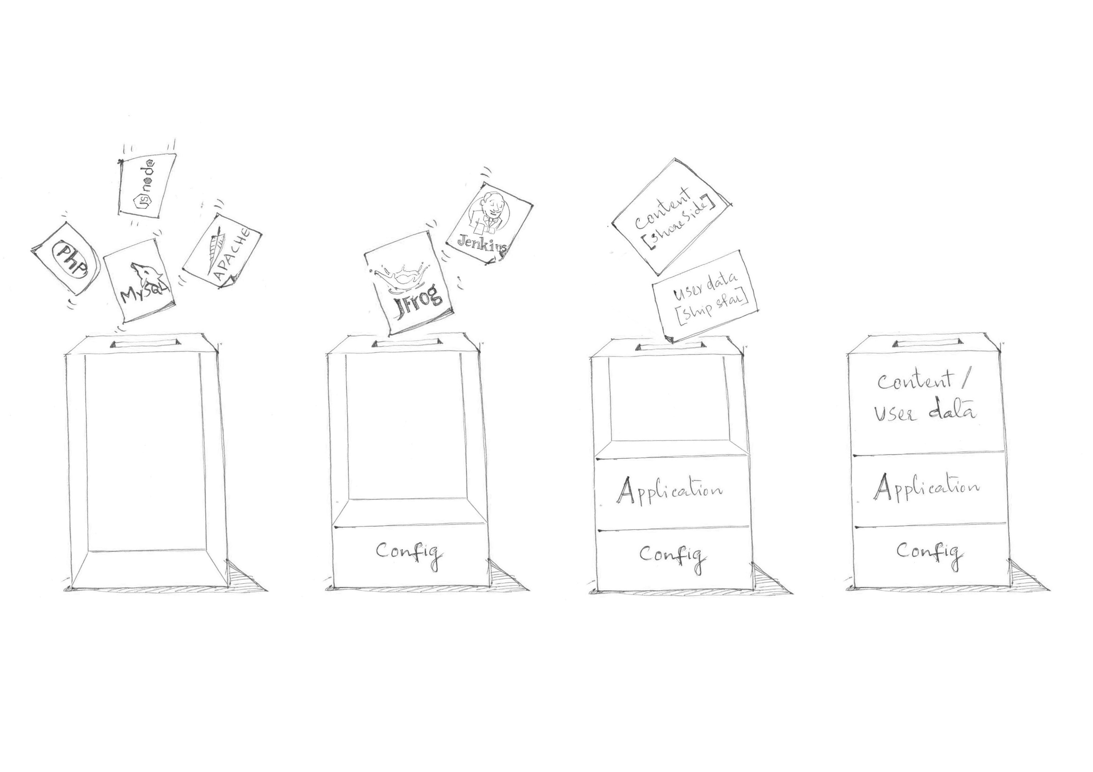
Behind the Scenes…
Salt Minion builds App Server from MASTER
Jenkins builds latest Application from Artifactory
Application fetches latest Content and User Data from Shore Server and Web services
Princess@Sea is Up and Running

Slide 26
Who’s in?
Just about everybody:
Amazon, Microsoft, Google, Facebook, Twitter, yahoo, Adobe,….

Slide 27
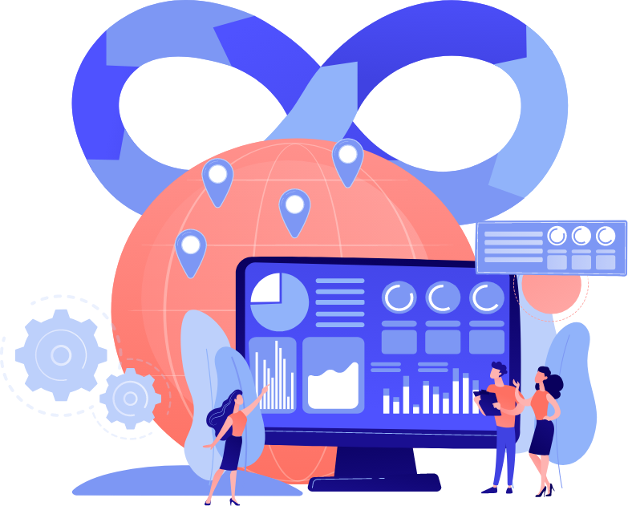
DevOps Global Market Trends
The Global DevOps market is expected to grow from USD 3.42 Billion in 2018 to USD 10.32 Billion by the end of 2023. That said, the compound annual growth rate during the forecasted period is calculated to be around 24.7%.
Source:
https://www.weblineindia.com/blog/all-about-devops-automation/

Slide 28
DevOps
Automation Everything You
Need to Know
Dr. Farhan Aadil
CS Department, CUI Attock

Slide 29

THE BASICS
Who is Dev?
Who is Ops?

Slide 30
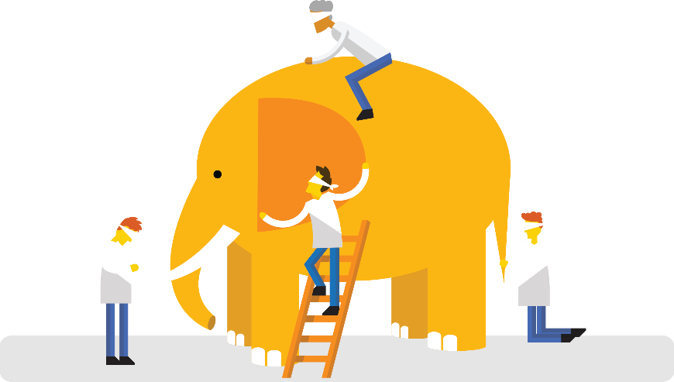
“DevOps is development and operations collaboration”
“DevOps is treating your infrastructure as code”
It’s DevOps!
It’s DevOps!
“DevOps is using automation”
It’s DevOps!
“DevOps is feature switches”
It’s DevOps!
“DevOps is small deployments”
“Agile for Ops?”

Slide 31

What is DevOps
According to George Spafford, Senior Director Analyst at Gartner,
“People-related factors tend to be the greatest challenges—not technology.”
You see, DevOps is not a tool. DevOps is not a job title.
DevOps is the practice of development and operations engineers working together through the entire software development lifecycle, following Lean and Agile principles that allow them to deliver software in a rapid and continuous manner.
If you want to do it fast …and you want to do it continuously, then you need to adopt a shared mindset that is at the heart of the DevOps culture.
So, how do you change a culture?
I like to say:
We don’t “do” DevOps… we “become” DevOps!

Slide 32
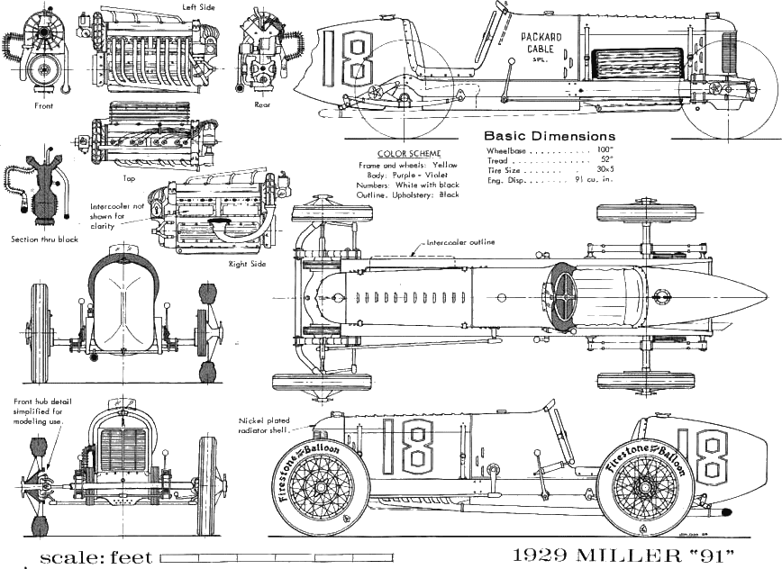

Traditional Development
The Inventors
Create new features and functionality in “dev” environment
Occasionally deliver new product to operators, along with instructions
May incorporate feedback from operators in future deliveries
Rewarded for delivering new features
The inventors are responsible for changing the system

Slide 33


Traditional Operations
The Mechanics
Receive new products from developers to be installed and operated
Expected to keep production systems up and running
Track problems, deployment failures, and system outages
May provide feedback to the inventors for future consideration
Penalized for downtime
The mechanics are responsible for keeping the system in operation

Slide 34

Where did DevOps come from?
There are tons of stories about the DevOps origins, but it is not created out of the whole cloth. Its seeds were planted many years ago and recently nurtured by expert IT professionals in several disciplines. Two primary ancestors of DevOps are given below:
ESM (Enterprise Systems Management): People involved in the initial phases of DevOps are system administrators. These experts brought the key ESM practices to DevOps like configuration management, automated provisioning, system monitoring, the toolchain approach, etc.
Agile Development: DevOps can be considered an outgrowth of agile. It is simply extending the Agile principles beyond the boundaries of the code to the entire delivered services.

Slide 35

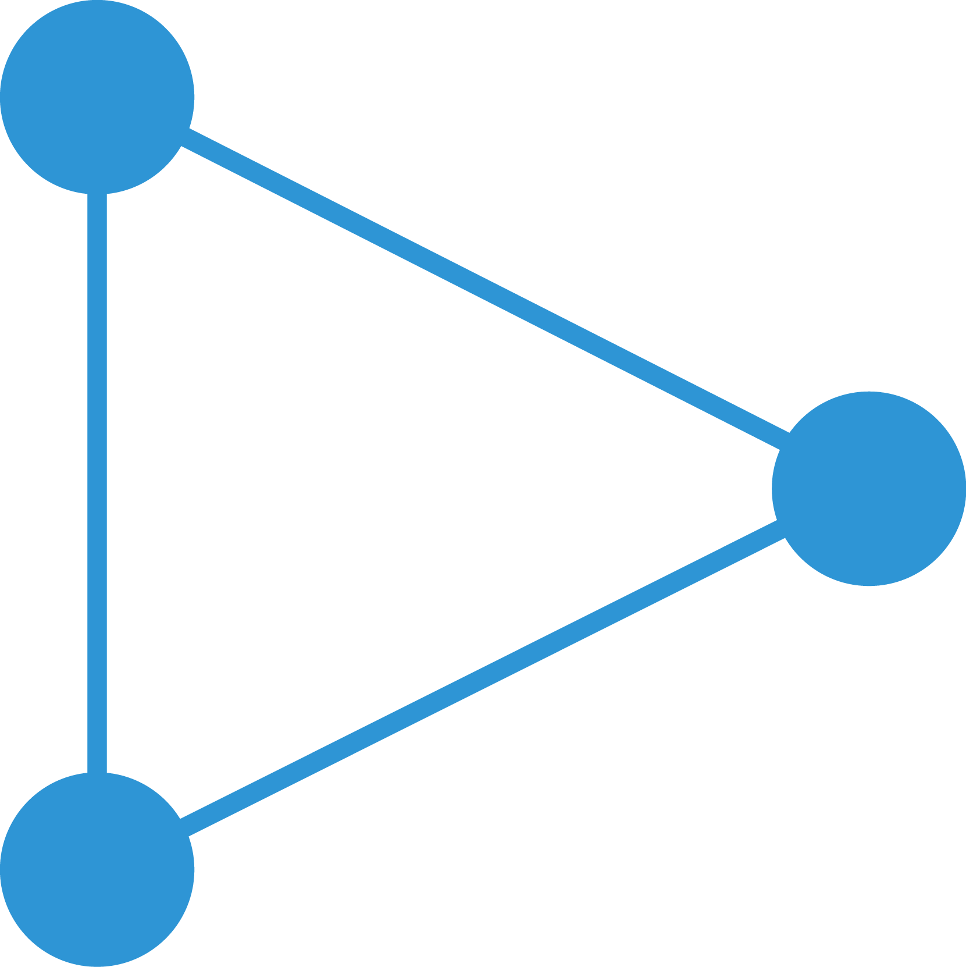
Evolution towards agile/DevOps
DevOps is built on agile principles and provides a platform for greater speed, versatility and agility
Waterfall
Agile
DevOps
Long pre-planned release cycles
Can be difficult to change direction
Business may wait a long time for delivery
Short & frequent releases
More responsive
Business gets new features faster
Testing, risk, impact and recovery time are low
Continuous delivery to business
Highly responsive
Automation reduce risks and improves quality
Greater business alignment & satisfaction
Improved productivity & efficiency

Slide 36
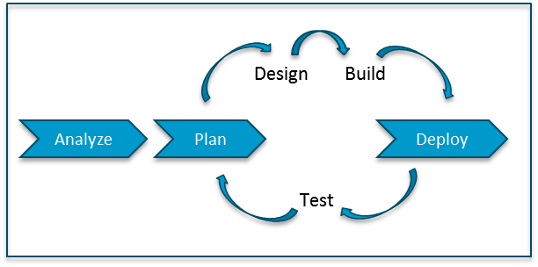
Waterfall vs. Agile Dev Methodologies
Waterfall
Analyze
Plan
Design
Build
Test
Deploy
Agile
Project Timeline
Requirements
Change
Customer
Turnover
Technology
Innovation
Source: http://www.kenwayconsulting.com/agile-or-waterfall-let-the-organization-decide/
Notes:
This slide describes the two most common development methodologies. Waterfall first used in 1956 but more popularized in 1970, and Agile first coined in 2001 and gaining in popularity with the rise of consumer Internet companies and cloud computing. While the sub-phases are generally the same, the difference is one single end-to-end phase for Waterfall compared to smaller phases, called “sprints”, for Agile.
This sprint approach comes from the understanding that
1) all requirements are not known upfront,
2) even if they are known, the requirements will change when you start interacting with users,
3) customers that you start building a product for changing their mind or the need change, and
4) technology comes out at such a new pace that you benefit from using new technologies sooner.

Slide 37

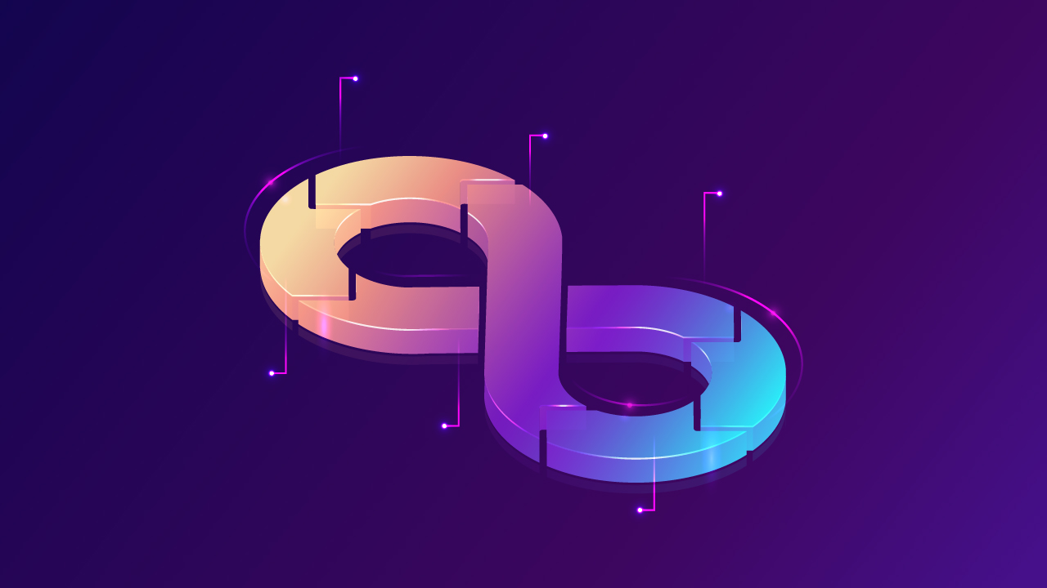
How DevOps Lifecycle Works?
1. Development
2. Integration
3. Testing
6. Operation
5. Deployment
4. Monitoring
Source:
https://www.weblineindia.com/blog/all-about-devops-automation/

Slide 38
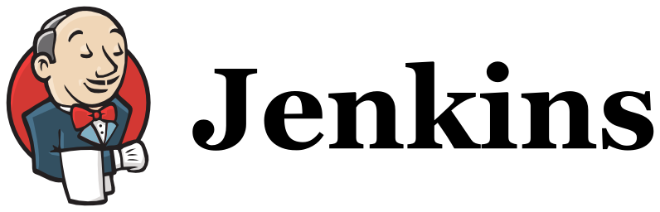
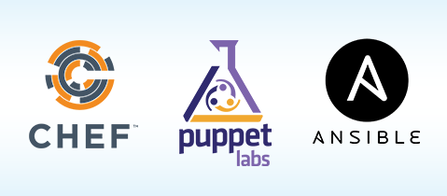


Agile (Dev) + Deploy (Ops) → Automation
DevOps
Continuous
Integration
Continuous
Deployment
Continuous
Integration
Continuous
Deployment
Continuous
Integration
Continuous
Deployment
Notes:
Agile can only succeed and be efficient if automation is used between all the steps in each sprint.
Performing all the processes and hand-offs manually within each sprint actually slows down the overall start-to-finish process.
Thus, Agile has given birth to new cottage industries and vendors providing consulting, training, and tools for these phases.
Continuous Integration is tools and processes that automate the development process of build and test, adding new functionality in small improvements.
Continuous Deployment is tools and processes that enable Operators to quickly and easily push new functionality, often one module at a time on live systems, without big monolithic releases and system downtime.
Some of the more popular Continuous Integration tools for Developers are Jenkins, Hudson, and Bamboo.
Some of the more popular Continuous Deployment tools for Operations are Chef, Puppet, and Ansible.

Slide 39
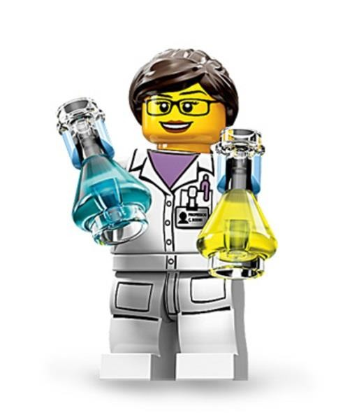

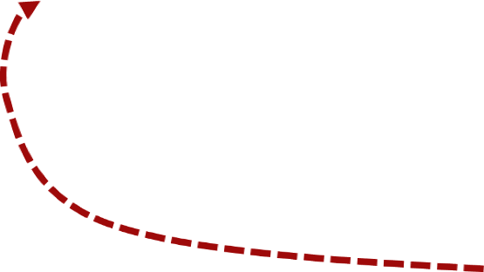
Differing Views on Change
Hero
Obstacle
Change Orientation
Stability Orientation
Alienate customers b/c system constantly changes
Alienate customers b/c system
doesn’t change
Logical extremes

Slide 40
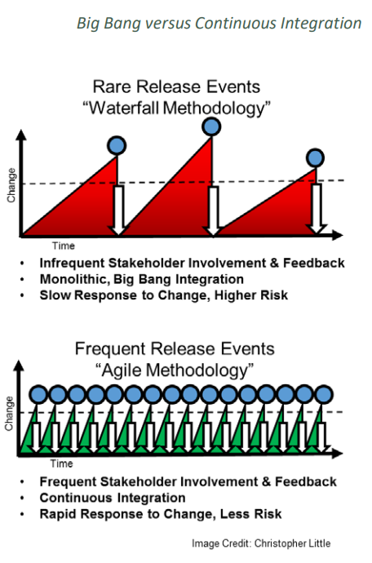
Big Bang vs. Continuous Integration
Story from book*

Slide 41

What problems led to the creation of DevOps?
DevOps implementation has increased the rate of software delivery and revenue for business stakeholders. The following listed reasons are the most considerable ones that led to the creation of DevOps.
Before DevOps, operation and development teams were working in an isolated environment.
Testing and Deployment activities mostly were performed in an isolated manner after the design-build step, and they took more time than the actual project completion time.
Team members usually spend a large amount of time deploying, testing, designing, and building the projects
Human production errors were deployed during manual code conduction.
Operations and coding teams generally had different timelines and did not have proper synchronization which results in further delay.

Slide 42

Traditional Development and Operations
DEV
OPS
Notes:
DevOps word in itself is a combination of two words one is Development and other is Operations.
It is neither an application nor a tool; instead, it is just a culture to promote development and Operation process collaboratively.
As a result of DevOps implementation, the speed to deliver applications and services has increased.

Slide 43
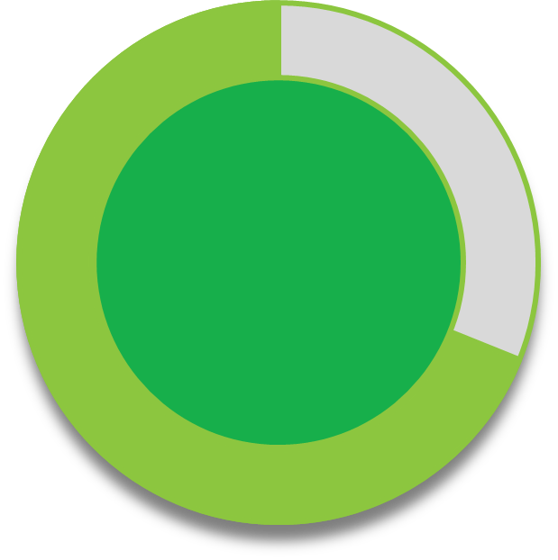

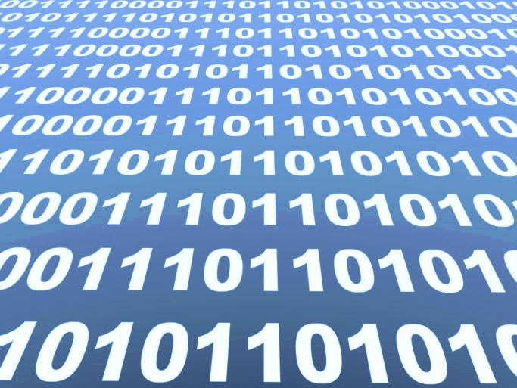
Organizations that effectively leverage software innovation outperform their competitors... yet few are able to deliver it effectively
86%
of companies believe software delivery is important or critical
of those who leverage software delivery today
But only…
69%
25%
outperform those who don’t
leverage software delivery effectively today
Source: “The Software Edge: How effective software development drives competitive advantage,” IBM Institute of Business Value, March 2013
Notes:
Main Point: We know organizations have a gap between the software delivery capabilities they need to succeed and the ones they have in-house currently.
Successful organizations know that when they improve their abilities in this area, they increase their success.
In fact an IBM study where organizations self-reported that... Insights from 435 executives in 58 countries, spanning 18 industries
85% realize and reported it is important to critical
Only 25% say they are able to fully leverage software delivery effectively
So there is a gap -- but when companies that can close the resulting execution gap stand to benefit.
Almost 70 percent of the companies currently leveraging software development for competitive advantage outperform their peers from a profitability standpoint
TRANSITION – so there is a huge opportunity for our clients to close that gap…let’s move to the next slide and talk about how
--------------------------------------------------------------------------------------------------
Note: Outperformers were determined by a self-assessment of profitability against peers in the industry, ranging from 1 (Significant underperformers) to 5 (Significant outperformers) Significant outperformers were ranked as a 5, Average performers a 3-4 and Underperformers 1-2
new Rational/WebSphere IBV Study "The Software Edge - How effective software development drives competitive advantage"
This study examined the correlation between software delivery competency and industry competitive advantage
Insights from 435 executives in 58 countries, spanning 18 industries
Roles included executives at director level and above in IT and other software organizations
Software delivery refers to all areas of development, operations, and support within IT and other development / engineering organizations
“There was 54% of the companies who said they believe software is critical and 32 percent who called it moderately important – so that’s 86 percent of the respondents say software is either critical or moderately important and that points to the need for better tooling for software development and delivery.” said Randy Newell, director of capabilities marketing for IBM Software Group with a focus on the Rational brand.
43

Slide 44

Yes, you want speed . . .

Slide 45
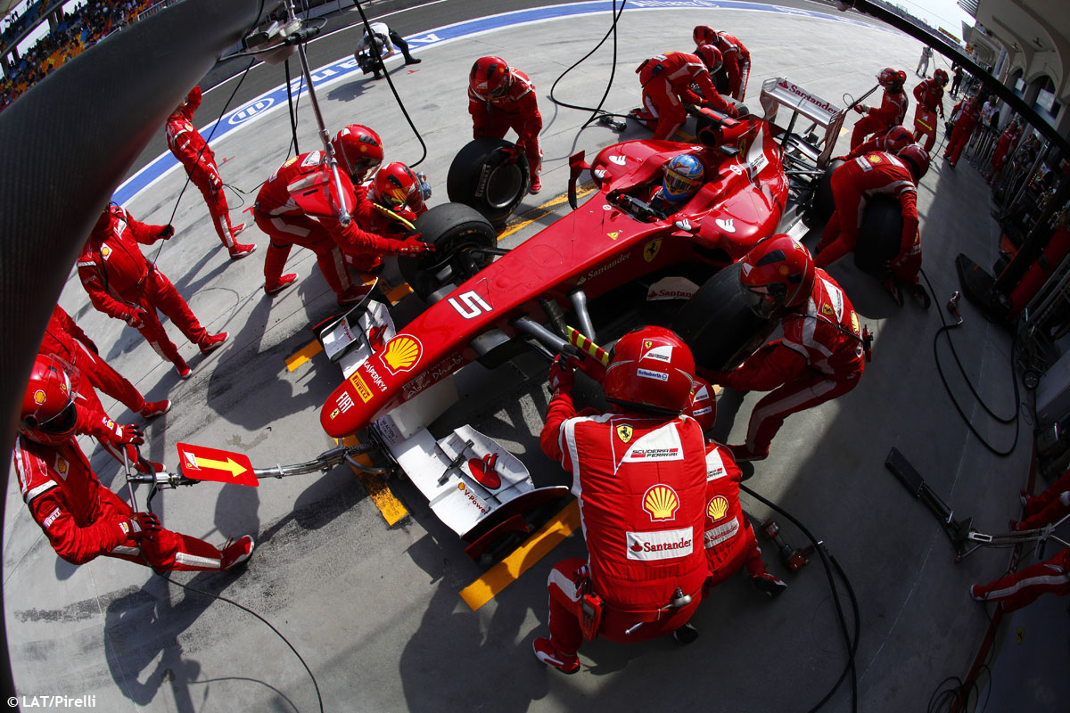
What you really want is quality at speed!

Slide 46
Development
Operations
Notes:
Graphic: https://www.brainvire.com/devops/ (with modifications from AFIT)
DEV/OPS uses automation and monitoring of short dev cycles, frequent deployments and aligns with business operations

Slide 47
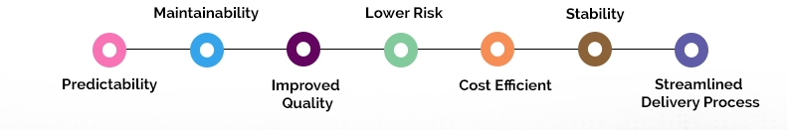
What are the Features of DevOps Implementation?
“DevOps is not a goal but a never-ending process of continual improvement.”
The DevOps offer continuous integration and continuous delivery (CI/CD). It makes the product delivery cycle quicker, and enterprises become able to launch the software timely without compromising its quality.
Following are the factors that will improve as a result of DevOps implementation:
Predictability: DevOps decreases the failure rate of new product releases.
Maintainability: The process improves the overall recovery rate at the time of the release event.
Improved Quality: DevOps improves the quality of product development by incorporating infrastructure issues.
Lower Risk: Security aspects are incorporated in SDLC, and the number of defects gets decreased across the product
Cost Efficient: Cost efficiency is improved due to DevOps which is always an aspiration of every business organization.
Stability: DevOps implementation offers a stable and secure operational state.
Streamlined Delivery Process: As DevOps provides streamlined software delivery, the marketing effort is reduced up to 50%. It happens due to mobile applications and digital platforms.

Slide 48
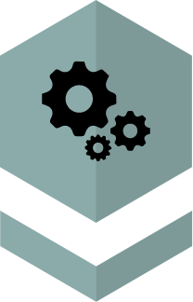

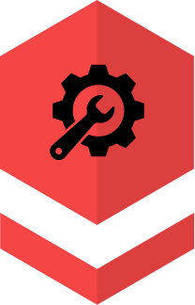
To understand DevOps better you need to know it consists of three fundamental ideas.
Practices and Process
People and Culture
Tools and Techniques
Source:
https://www.weblineindia.com/blog/all-about-devops-automation/

Slide 49
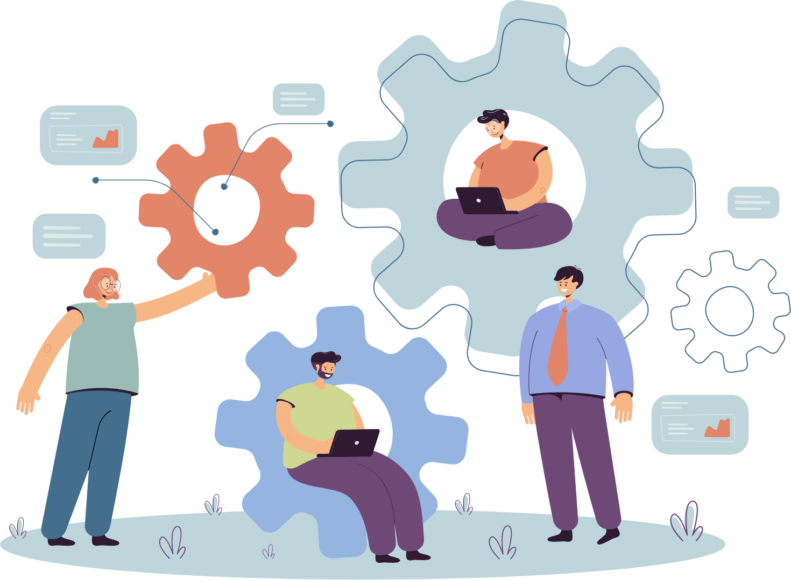
DevOps is a combination of practices, cultural philosophies, and tools that enhance an organization’s ability to provide services and applications in an expedited manner.
It also enables the improvement and evolution of products at a rapid pace than the organizations which employ traditional development software and infrastructure management processes.
Source:
https://www.weblineindia.com/blog/all-about-devops-automation/

Slide 50
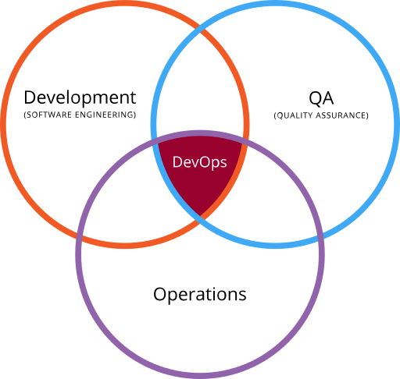
DevOps
DevOps is the intersection of development (software engineering), operations and quality assurance (QA)

Slide 51

What is Automation in DevOps?
Automation in DevOps makes the entire process smooth, and all conventional manual software development barriers become scalable and manageable. Furthermore, it helps to efficiently manage and run an application in the development environment with frequent updates. It also needs strict testing standards.
Source:
https://www.weblineindia.com/blog/all-about-devops-automation/

Slide 52

To sum it up

Slide 53








Benefits of DevOps Automation
Removes Manual Error
Shorter
Development
Cycle
Increases
No.Of
Deliveries
Latency
Removed
Improved
Defect Detection
Reduced
Deployment Failures and Rollbacks
Reduced Time
to Recover Upon Failure
Source:
https://www.weblineindia.com/blog/all-about-devops-automation/

Slide 54


DevOps Trends in 2023
3.DevSecOps will become a default part of DevOps
2.Focus on Edge-
Computing
4.Migration
to Serverless Architecture
1.Becoming
Cloud-Centric
5.DevOps Automation
Source:
https://www.weblineindia.com/blog/all-about-devops-automation/

